Slide 1
MATERIAL RESOURCES PLANNING. (MRP).
A case of PEPSI Co.

Slide 2
Introduction.
MRP manages the manufacturing process in an organization.
Software-based program is the most appropriate to conduct MRP.
Pepsi uses the MRP to make estimates of raw materials and plan their deliveries.
MRP is important in improving the productivity of a company.
Notes:
The purpose of MRP is to provide for management of the manufacturing process in a company such as Pepsi. It takes control of the raw materials up to the production of the final product. The most convenient and effective way to conduct MRP is to use computer software that lacks human intervention. Pepsi utilizes such computer-generated software. MRP plays an important role in improving the productivity of a company.

Slide 3
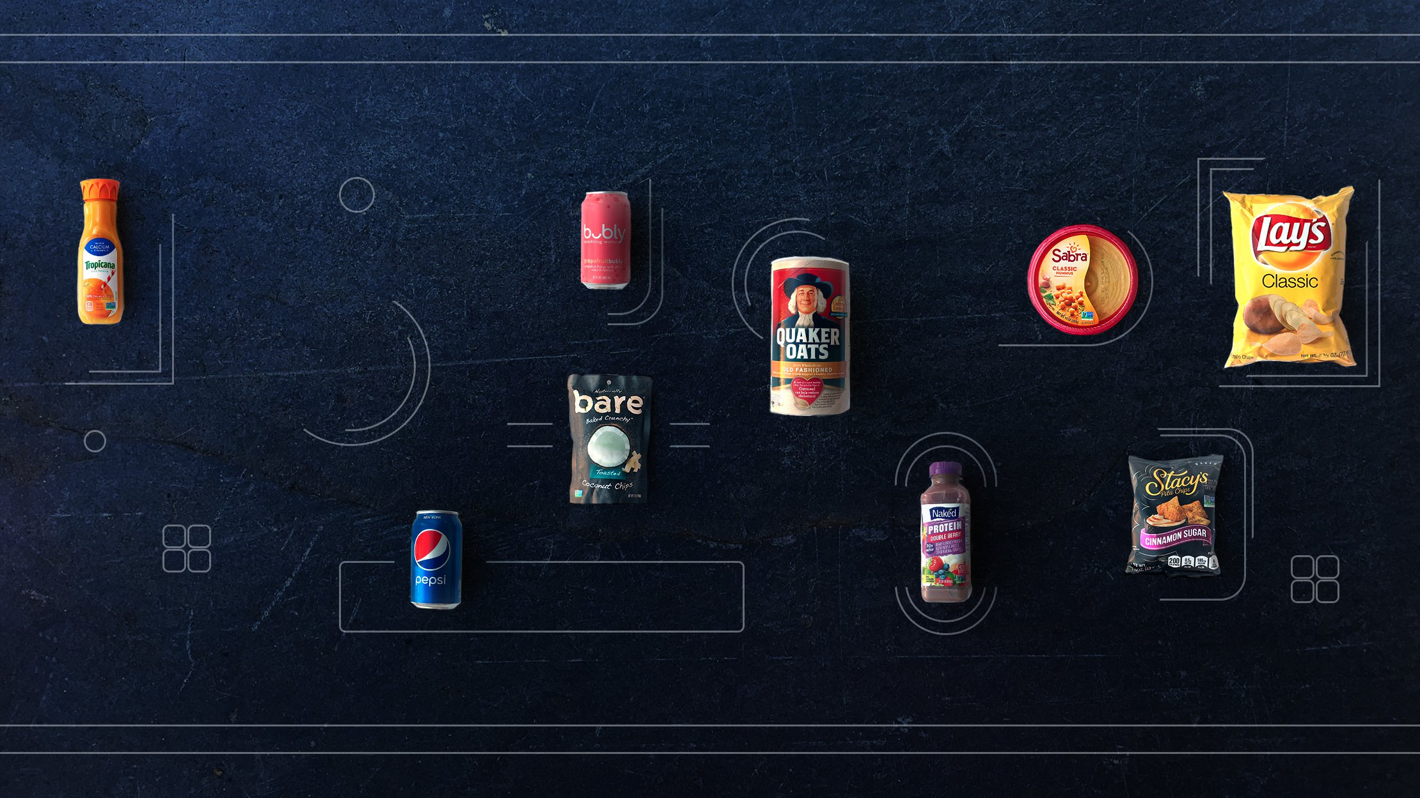
Pepsi Company.
Its vision is to be a global leader in convenient food and beverages.
It is a company that is specialized in the manufacturing of beverages.
MRP would facilitate the planning of manufacturing in its seven divisions.
Pepsi vision enabled to them become the leading food and beverages companies.
Notes:
Pepsi co. is one of the leading companies in the line of beverages and food production. MRP would be very beneficial to the company in realizing its vision of becoming a global leader in the industry. It would facilitate the scheduling and delivery of raw materials for efficient manufacturing in all its seven divisions. It stands to benefit a lot from an efficient MRP system that is computerized to enable easy management of the different divisions.

Slide 4
Functions of MRP.
Inventory control.
Elementary scheduling of deliveries.
Plan purchases and distribution programs.
Planning the manufacturing process.
Notes:
MRP plays an important role in the manufacturing company. One of the functions is that it enables a company to maintain low inventory levels that reduce overhead cost. It also promotes easy scheduling of deliveries of either raw materials or products. The MRP also enables the planning of purchases of raw materials and the distribution of manufactured goods across different markets. Finally, it also enables the company to plan on manufacturing and for maximum profits.

Slide 5
Opportunities for Pepsi for efficiency on MRP.
Integrating a computerized MRP system that is free from human intervention.
Plan manufacturing of products according to the varying needs in the market.
Pepsi may schedule deliveries of raw materials to ensure continuous production.
Purchase records are maintained to ensure efficient accounting.
Notes:
Pepsi can benefit from an efficient MRP system in various ways besides ensuring a continuous and low cost of production. The company should integrate a system that is computerized and free from human intervention can be more efficient in tracing over expenditure and reduction of wastage. The company can plan manufacturing efficiently by considering the varying market needs. Purchase and deliveries of raw materials can be scheduled to ensure production is not stalled. The recording of purchasing records enables easy bookkeeping and auditing of expenditure when determining the cost of production.

Slide 6
References.
https://www.pepsico.com/about/about-the-company

